Slide 1
Introduction
Comparative Analysis of Depreciation Methods: Straight-Line vs. Diminishing Balance

Slide 2
Key Findings
Straight Line Method
Asset Price : 5,00,000
Total Depreciation For Its Life Span : 4,50,000
Depreciation Percentage : 9%
Depreciated Book Value After Its Lifespan : 50,000
Diminishing Balance Method
Rate of Depreciation as per Diminishing Balance Method : 20.57 %
Year on year depreciation amount.
Book Value at the end of each year : 50,000

Slide 3
Actionable
Use Straight-Line for simplicity and uniform expense reporting.
Opt for Diminishing Balance when early-year tax benefits or accelerated expense recognition is preferred.
Match depreciation method to asset usage and accounting goals.

Slide 4
Methodologies
Straight Line Method:
Annual Depreciation= (Asset Cost−Scrap Value)/LifeSpan
Diminishing Balance Method: Depreciation=Book Value*Depreciation Rate
​

Slide 5
Approaches
Straight-Line:
Equal depreciation annually ($45,000)
Easy to apply and predictable
Diminishing Balance:
Higher depreciation in initial years
Reflects rapid early asset value decline

Slide 6
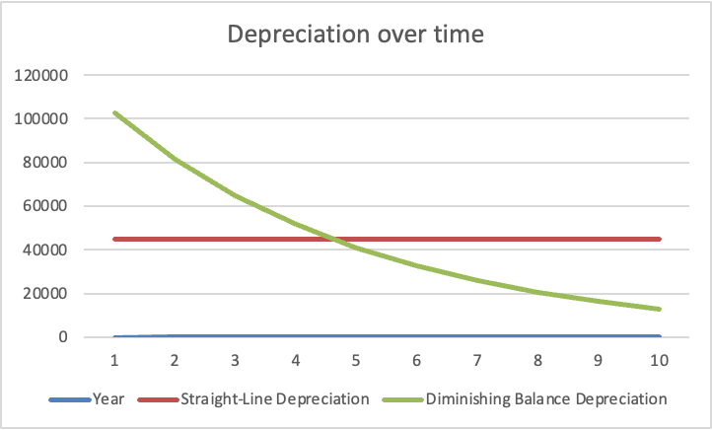
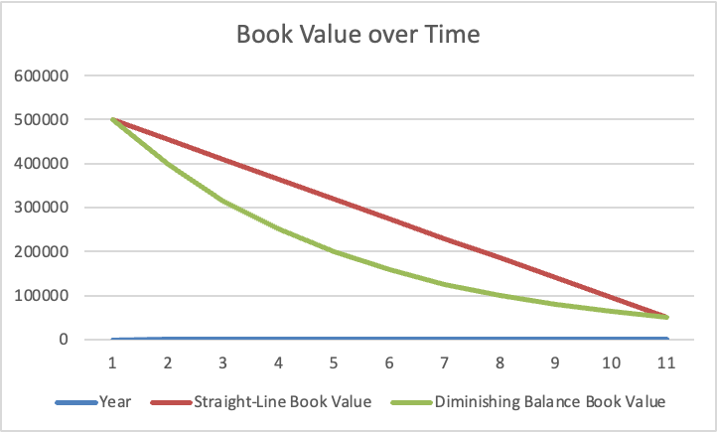
Insights
Both methods lead to the same final book value and total depreciation.
The impact on cash flow and taxes varies due to timing.
Businesses favoring short-term gains often prefer diminishing balance.

Slide 7
Conclusions
Choose method based on:
Asset usage pattern
Financial strategy
Compliance requirements
Recommendation: Align depreciation method with financial planning and reporting objectives.

